Slide 1
The Value of Sports and Entertainment
SEM

Slide 2
Sports marketing is a growing division of the marketing field that focuses on the business of sports and the use of sports as a marketing tool.
People spend time and money on sports because they feel excitement and are entertained by the competition and spectacle of sports.
Sports marketers sell sports, games, and services to these fans.

Slide 3
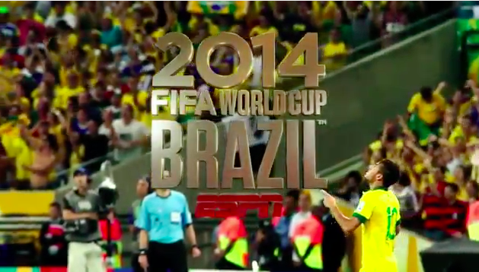
View the ESPN commercial below and consider the economic impact of the recent FIFA World Cup in Brazil.
It has been estimated at 3.7 million people traveled throughout Brazil injecting $3.03 billion into the economy.
https://www.youtube.com/watch?v=iKGS6FKvJv0&feature=youtu.be

Slide 4

View the commercial below and consider the use of sports tied with an emotional connection to market products offered by Proctor and Gamble. This commercial celebrate America's moms who encourage their children to prevail through the thrill of victory and the agony of defeat.
https://youtu.be/1SwFso7NeuA

Slide 5

Visit the Website: www.kahoot.it
Enter The Game Pin
Introduction to Sports & Entertainment Marketing
Notes:
Teacher: https://play.kahoot.it/#/?quizId=b90b95a2-336b-476b-af6c-a673c7ae80c1

Slide 6
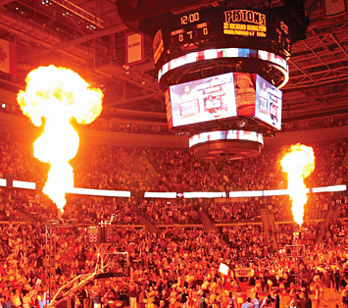
Economic Effect of Sports
11th largest of all U.S. industry groups
US’s output for sports goods and services estimated at $213 – 350 billion annually
How do we measure growth in the sports industry?
  Growth measured in:
    Attendance Figures
    Media Coverage
    Employment Figures (4.5 million jobs)
    Global Markets Sports Goods

Slide 7
Impact of Sports
Impact of Sports and Entertainment Marketing
  Generates an average of $400 billion in annual revenue.
  64% of Americans watch NFL football
  The NFL has $20.4 billion in television deals with CBS, FOX, ABC, and ESPN
  21,876 was the average NBA attendance in 2013
  Over 65 million people attended MLB games in 2013

Slide 8
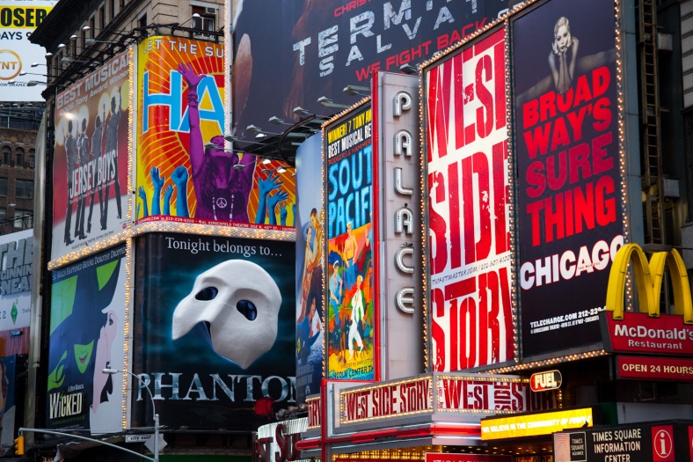

Economic Effect of Entertainment Industry
1.36 billion tickets sold to movies in 2012
Highest grossing film of all time - Avatar $2.7 billion
$16 million goes through Broadway a year
Fortune 500 Ranking
  Walt Disney 65
  News Corp 83
  Time Warner 95
  Harrah’s Entertainment 264
  Ceasars Entertainment 277

Slide 9
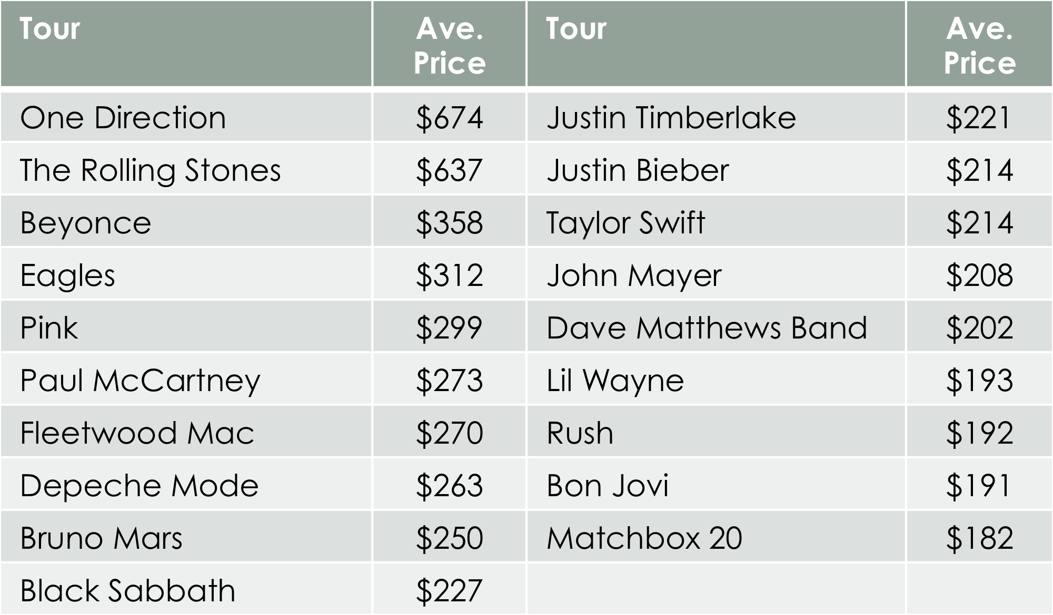
Ticket Prices

Slide 10
Disney World
Disney World Fun Facts
  2011 Attendance Figures ~ 47 million visitors
    Magic Kingdom, 16.97 million visits (No. 1 worldwide)
    Epcot, 10.83 million visits (No. 5)
    Disney's Animal Kingdom, 9.67 million visits (No. 7)
    Disney's Hollywood Studios, 9.60 million visits (No. 8)
  75 million Cokes consumed each year

Slide 11
Technology
Technology improvements, including the internet, have facilitated distribution of sports and entertainment to the masses.
  2012 Olympics
    4 billion television viewers worldwide
  29 million video requests from website
      Watch ESPN, HBO on the GO, NBC sports, etc…

Slide 12
Emotional Value
Emotional connections to teams and celebrities motivate fans to buy tickets to games, buy merchandise, movie tickets, etc…
Fans want products and services that identify them with winning teams and athletes.
Marketing efforts may need to be tweaked based on changes in winning trends.
http://bleacherreport.com/articles/1414595-25-videos-of-insane-sports-fans-in-action/page/2
http://bleacherreport.com/articles/1414595-25-videos-of-insane-sports-fans-in-action/page/3

Slide 13
Economics of Sports and Entertainment Marketing

Slide 14
Profit and Revenue
profit
  the amount of money remaining from revenues after all expenses are paid
  Revenue
    the money a business receives from the sales of goods and services

Slide 15
Macro vs Micro
Economics
  the study of how goods and services are produced, distributed, and consumed
Macroeconomics
  the study of the economics of the entire society
Microeconomics
  the study of the relationships between individual
  consumers and producers

Slide 16
Macro vs Micro
Which one would Marketers in the S/E marketing be concerned with? Macro or Micro?? Why??

Slide 17
economic utility
  the amount of satisfaction a person receives from the consumption of a particular product or service

Slide 18
It takes money to make money
Profit is the primary purpose of sports and entertainment marketing.
Investors generally provide the funding for an event to cover all the costs that must be incurred before tickets are ever sold.
Investors are looking for a return on investment
  The percentage of the income from a event that is distributed to investors

